Slide 1
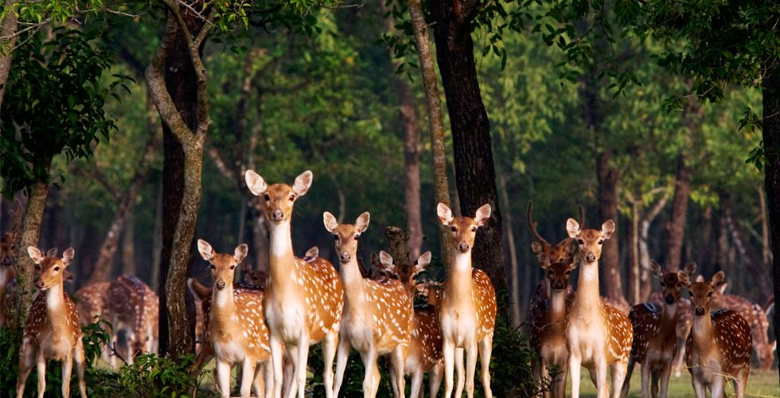
Nature of Beauty
Nature of Beauty

Slide 2
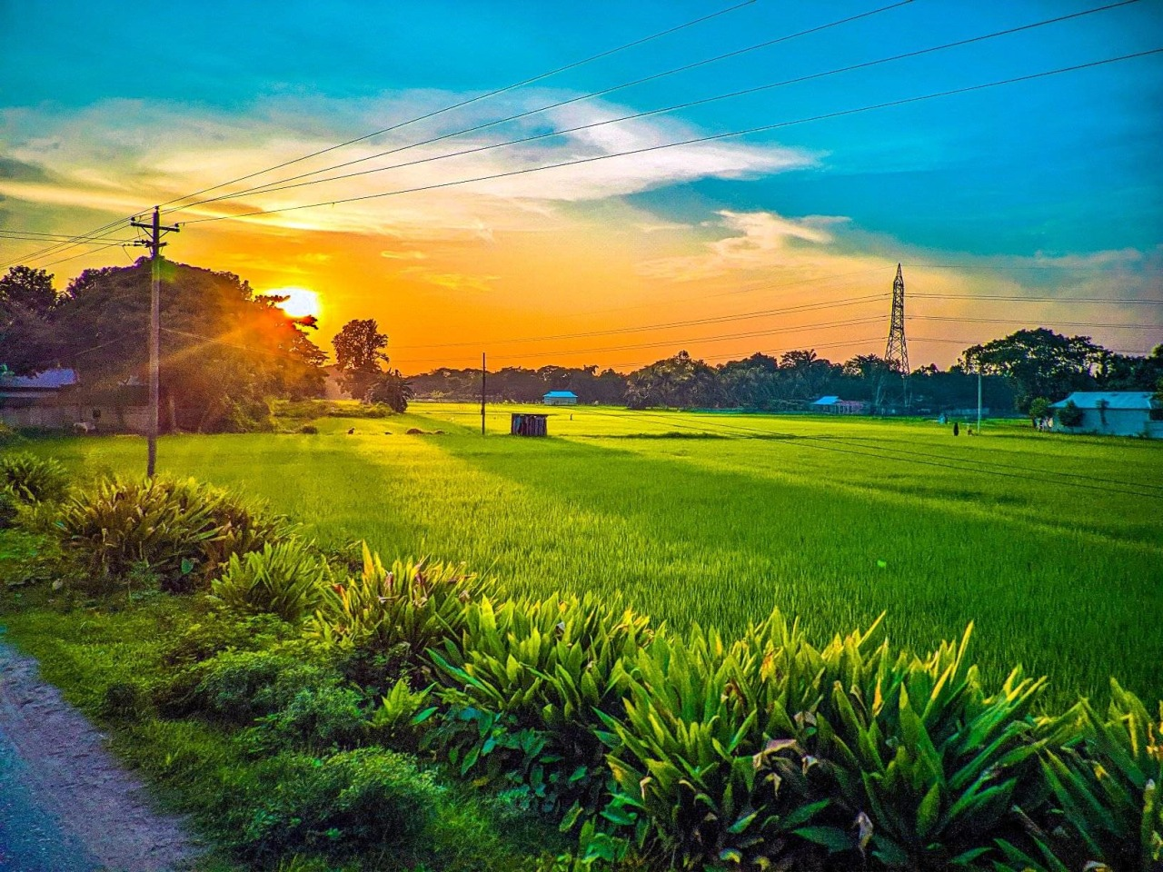
About Bangladesh
Bangladesh is called a paradise of natural beauty. A South Asian country located on Bay of Bengal, it is characterized by greenery and many waterways. Bangladesh has a tropical monsoon climate with high temperatures and six seasons. Green forest, river, monuments, longest natural sea beach, ancient historical mosques and archaeological sites of this country easily attract people and that is why it is called ‘Rupsi Bangla’.
Facts
Official Name: People's Republic of Bangladesh.
Form of Government: Parliamentary republic.
Capital: Dhaka.
Population: 162,650,853.
Official Languages: Bangla (also known as Bengali)
Currency: Bangladeshi taka.
Area: 57,320 square miles (148,460 square kilometers)
* Bangladesh is famous for its culture and heritage. People of all religions live together such as Islam, Hindu, Christian, Buddhist and others in Bangladesh and maintain a good relation themselves.
* The Sundarbans is the world’s largest single Mangrove forests which is a UNESCO World Heritage Site and Cox's Bazar Beach is the longest uninterrupted natural sandy beach in the world.
* Bangladeshi is famous for ready-made-garments (RMG) and it ranks 2nd in the world.
* Jute is a also major part of the economy and culture of Bangladesh and is the second largest producer in the world. So it is called the 'Golden Fiber' of the country.
* Professor Muhammad Yunus who received Nobel Peace Prize in 2006 for Grameen Bank and their work.

Slide 3

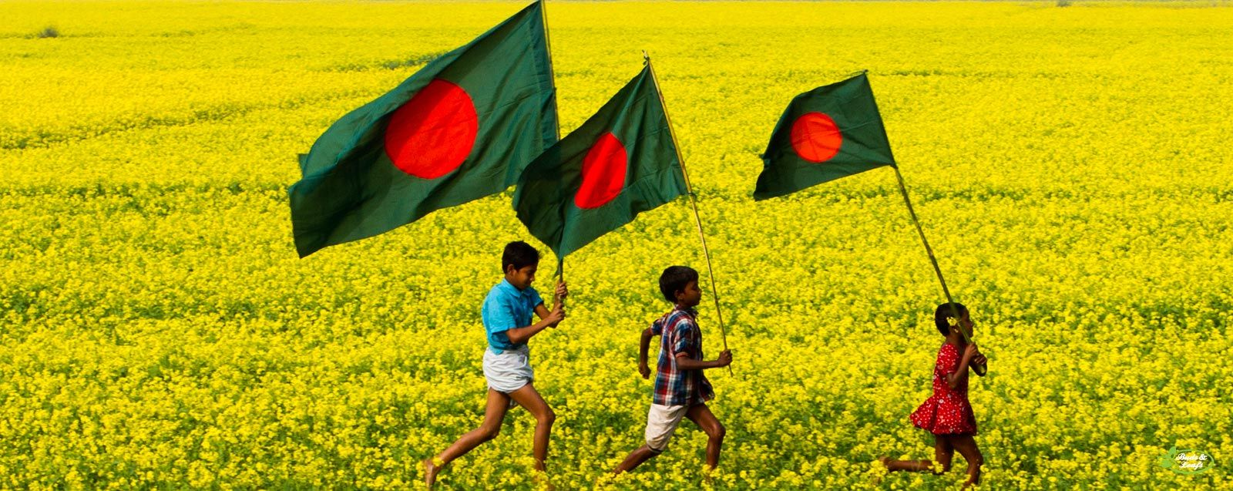
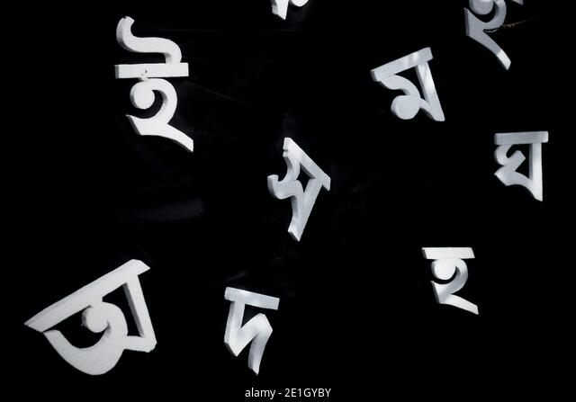

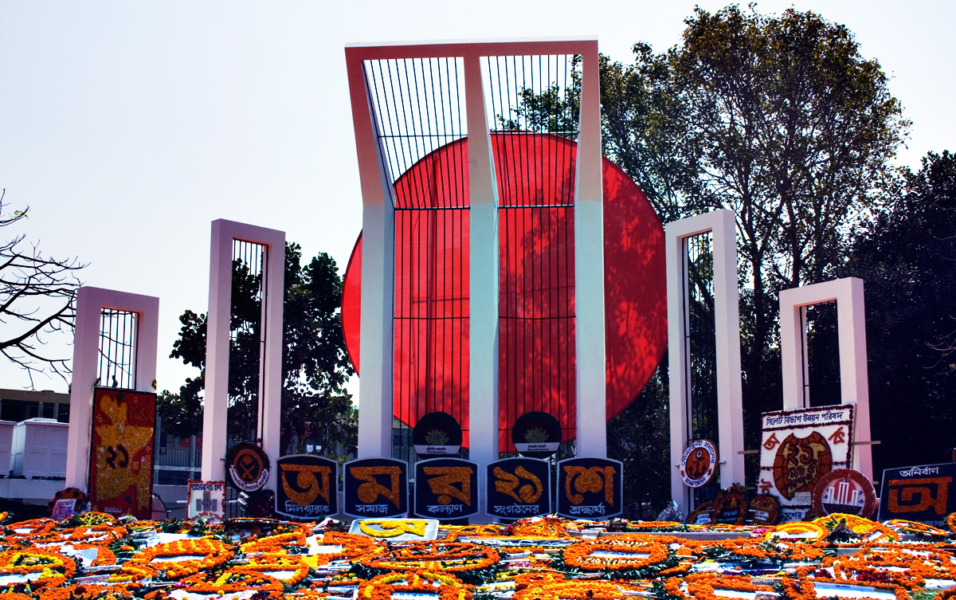
Language
Bengali is our mother tongue. It is known to everyone as Bangla. Many people martyred for this language. Bengal language is Seventh ranks in the world and UNESCO has declared 21st February as International Mother Language Day. We pay respectfully to the martyrs by laying flowers at the Shaheed Miner every year on 21st February.
Song - ‘আমার ভাইয়ের রক্তে রাঙানো একুশে ফেব্রুয়ারি, আমি কি ভুলিতে পারি’?
"February 21, stained in my brother's blood, can I forget“?
National Flag
2nd March is National Flag Day of Bangladesh. On this day in 1971, the first national flag was hoisted at Dhaka University. The national flag of Bangladesh is a red circle with in a green dark rectangle. The green colour symbolizes green nature and the red colour of the circle symbolizes the blood of martyrs for the country.
National Song – ‘আমার সোনার বাংলা, আমি তোমায় ভালোবাসি’।
‘My golden Bangla, I love you’.

Slide 4
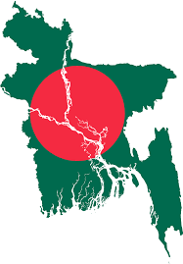
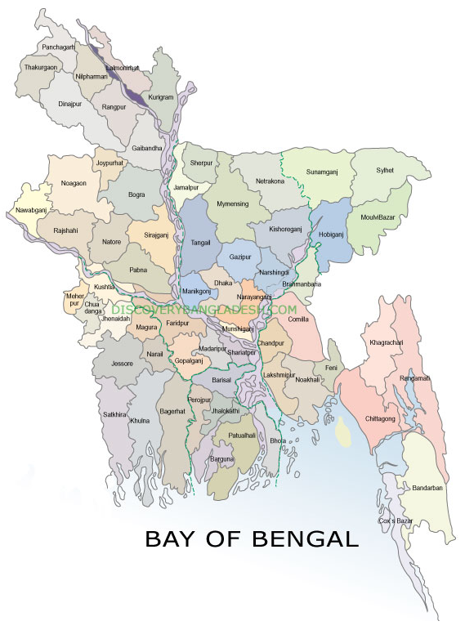
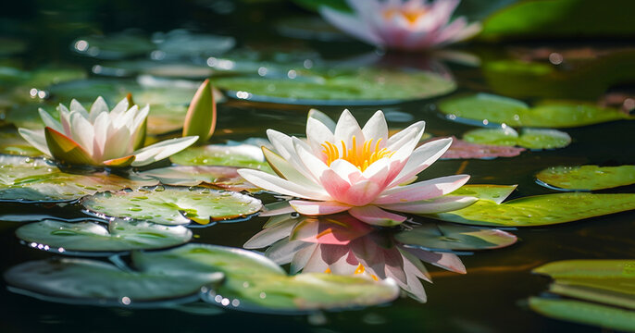
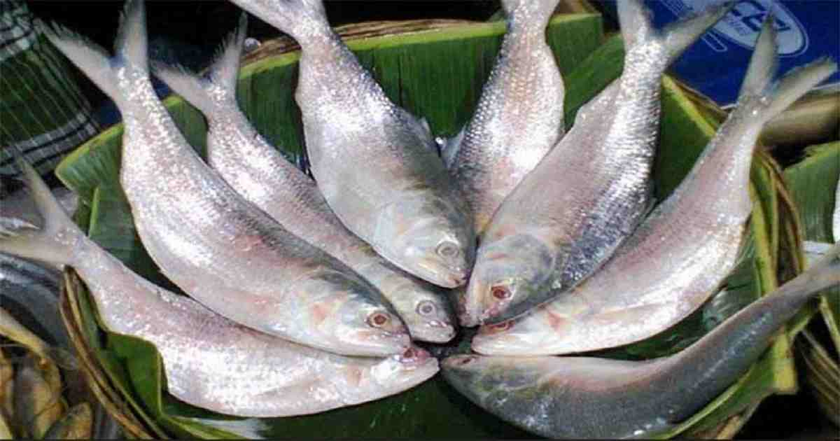
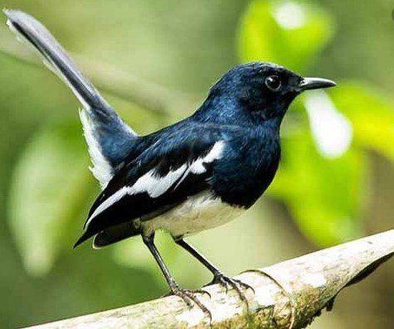
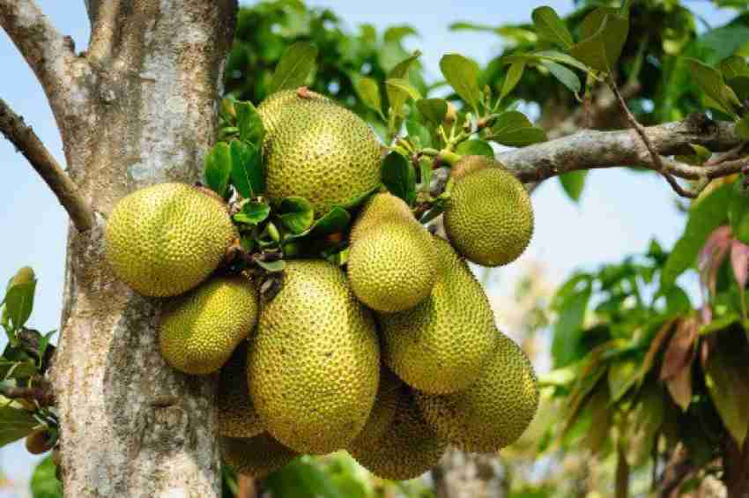
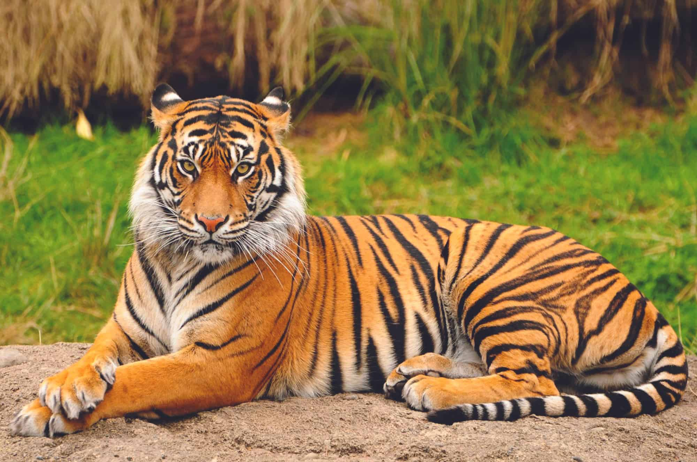
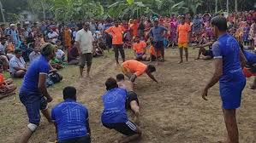
National things of Bangladesh
Flower
The national flower of Bangladesh is the ‘Water Lily’ and also known as Shapla. It is the state symbol of Bangladesh.
Fish
The national fish of Bangladesh is the ‘Hilsa’ and also known as Hilsa herring or hilsa shad and ilish.
Bird
The national flower of Bangladesh is the ‘Oriental magpie-robin’. Which is also known as the doyel in benglai.
Fruit
The national fruit of Bangladesh is the ‘Jackfruit’.
Animal
The national animal of Bangladesh is the ‘Royal Bengal Tiger’. The tiger is the symbol of strength.
Sports
The national sports of Bangladesh is the ‘Kabaddi’ It is also known as Ha-du-du.

Slide 5
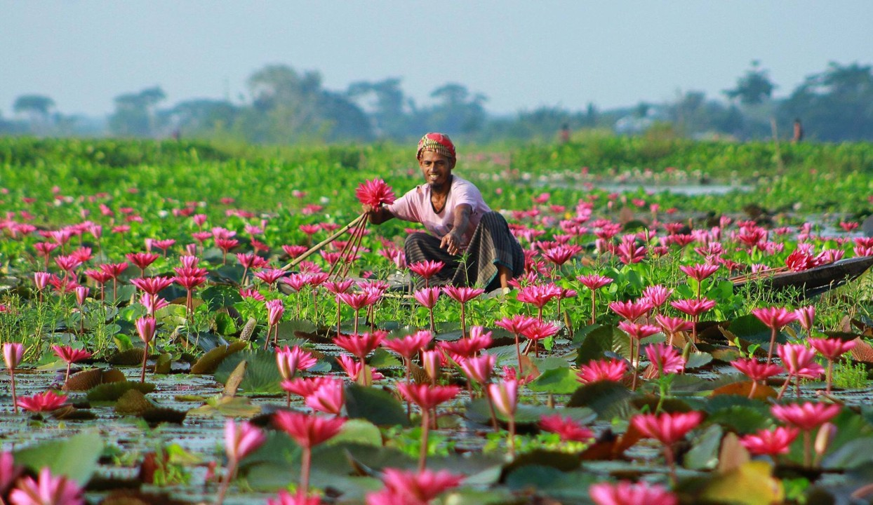
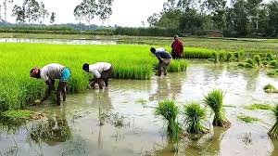
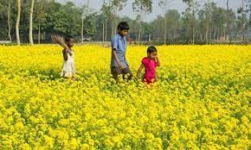
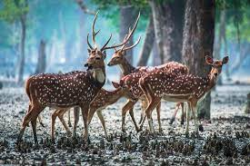
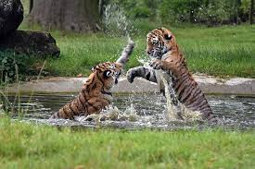
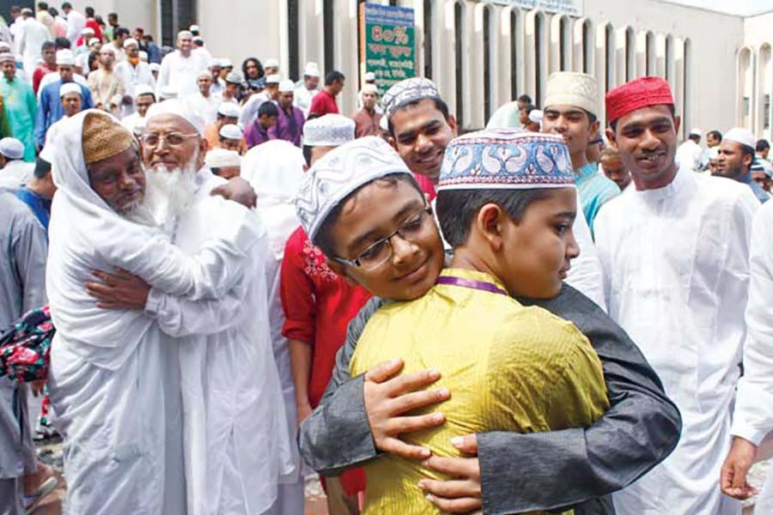
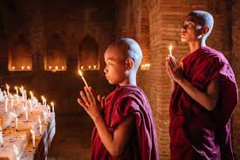
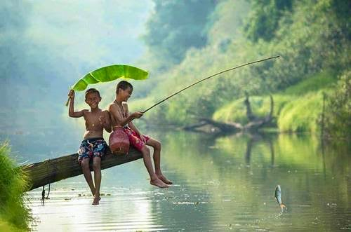
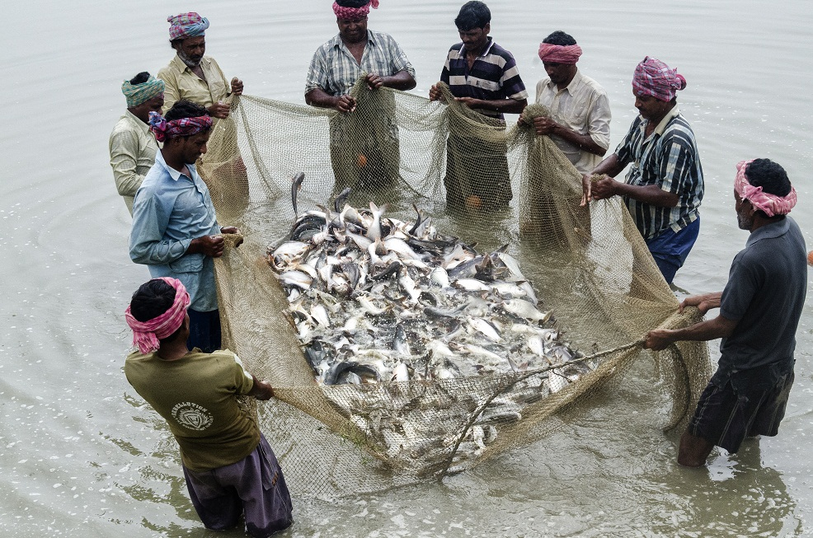
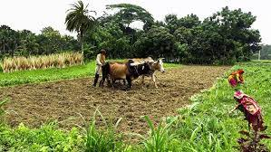
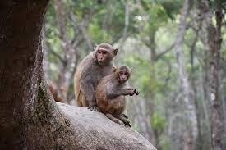
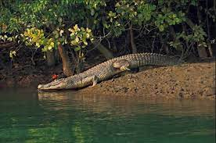
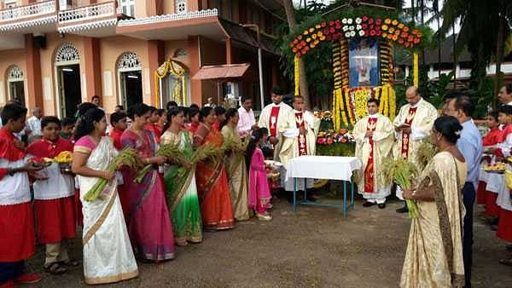
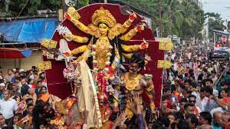
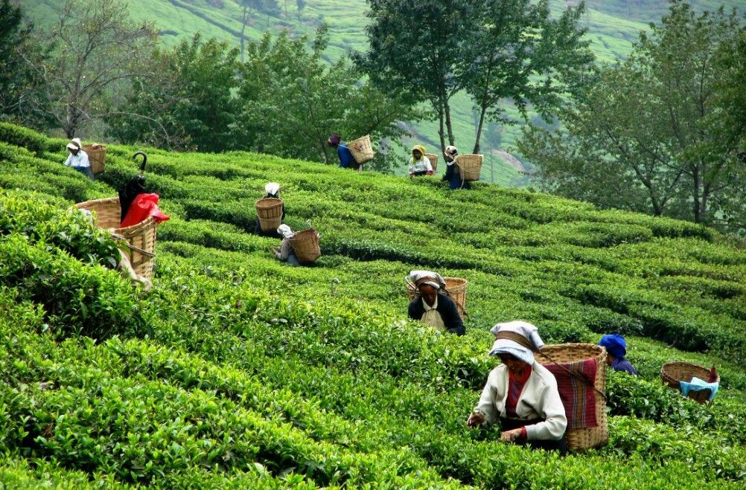
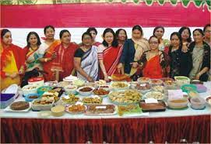
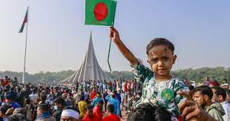
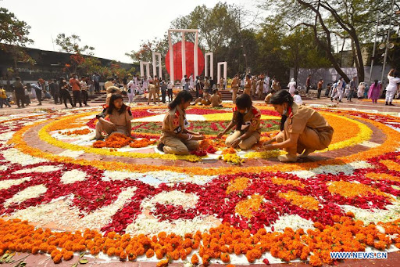
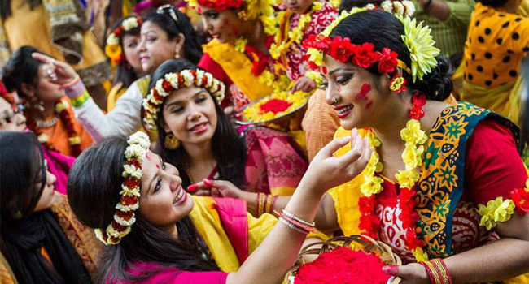
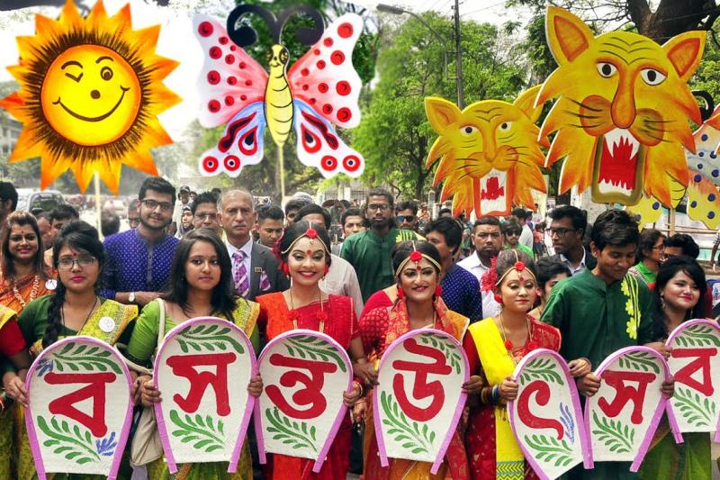
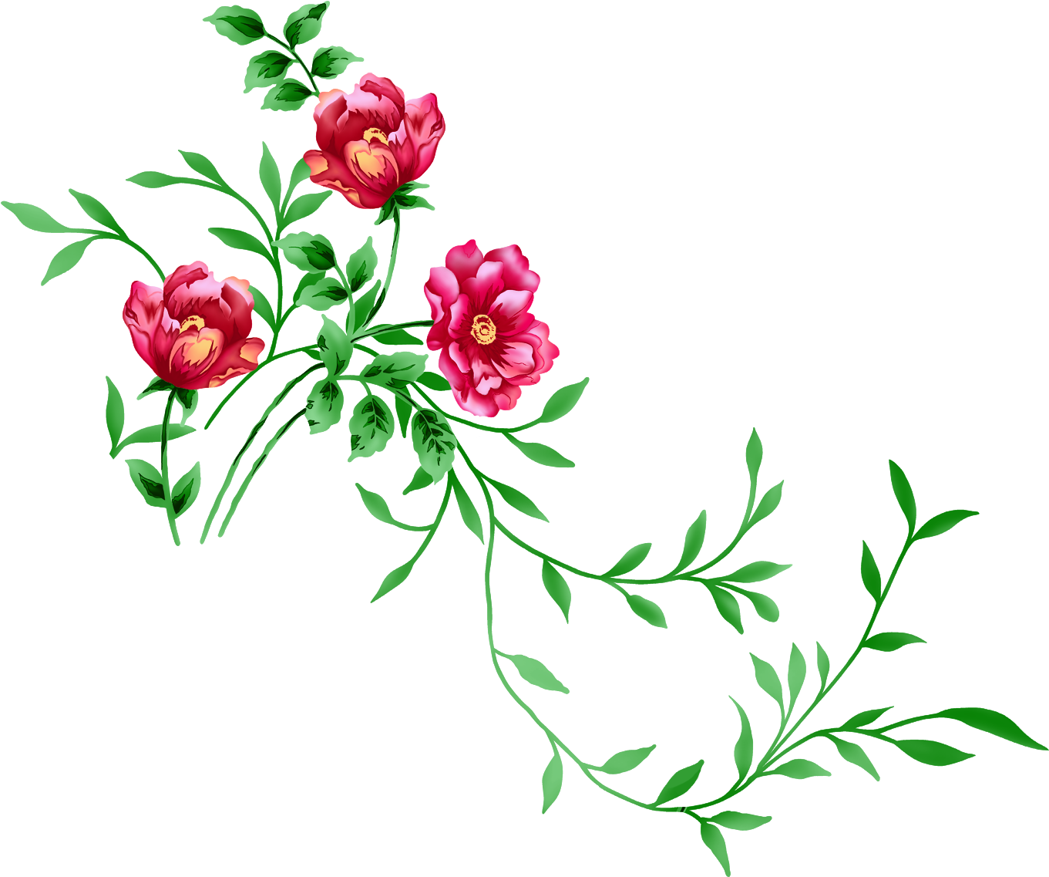
C U L T U R E
For every nation, its culture is an important part of social life. Bangladesh has a diverse culture. Its architecture, tradition, literature, music, dance, festivals, family, religion, painting, food and clothing are deeply rooted.

Slide 6

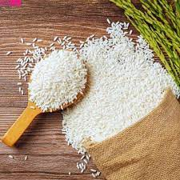
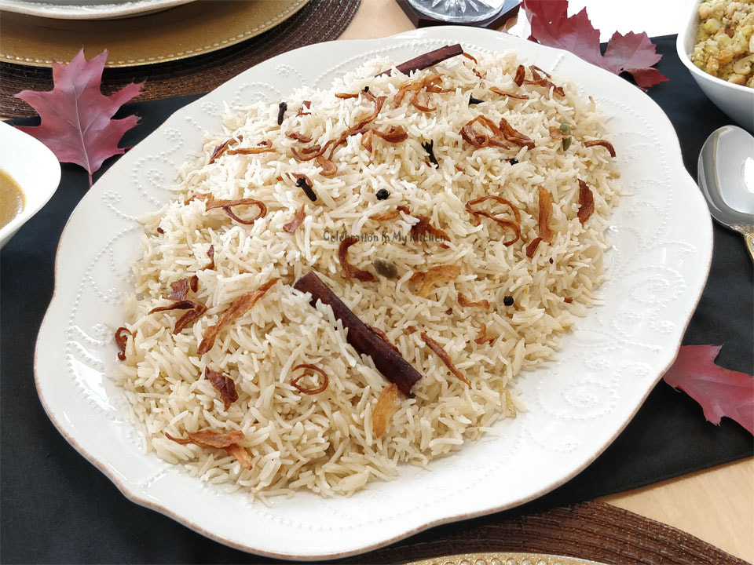
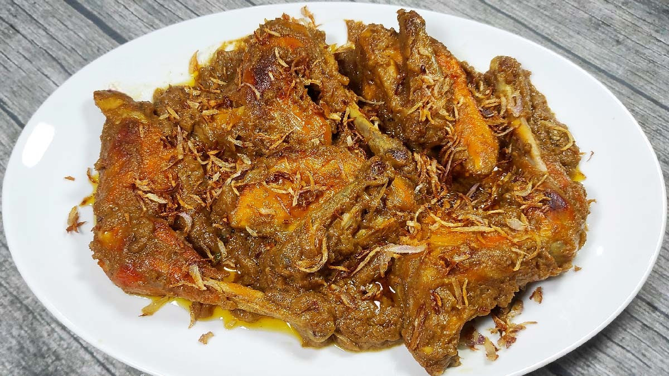
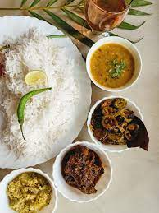
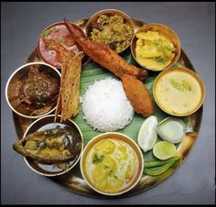
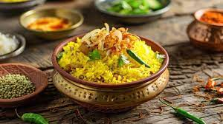
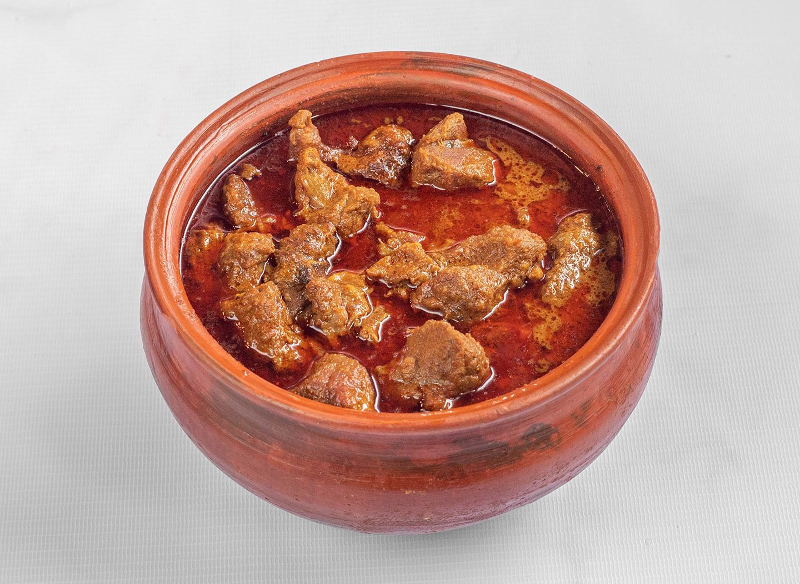
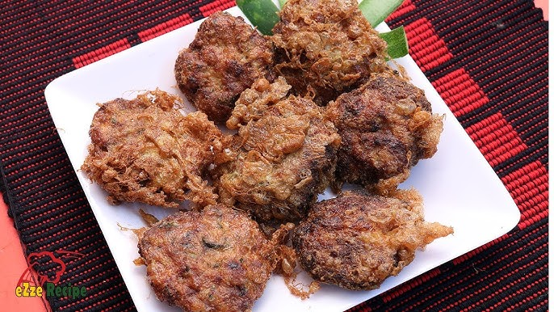
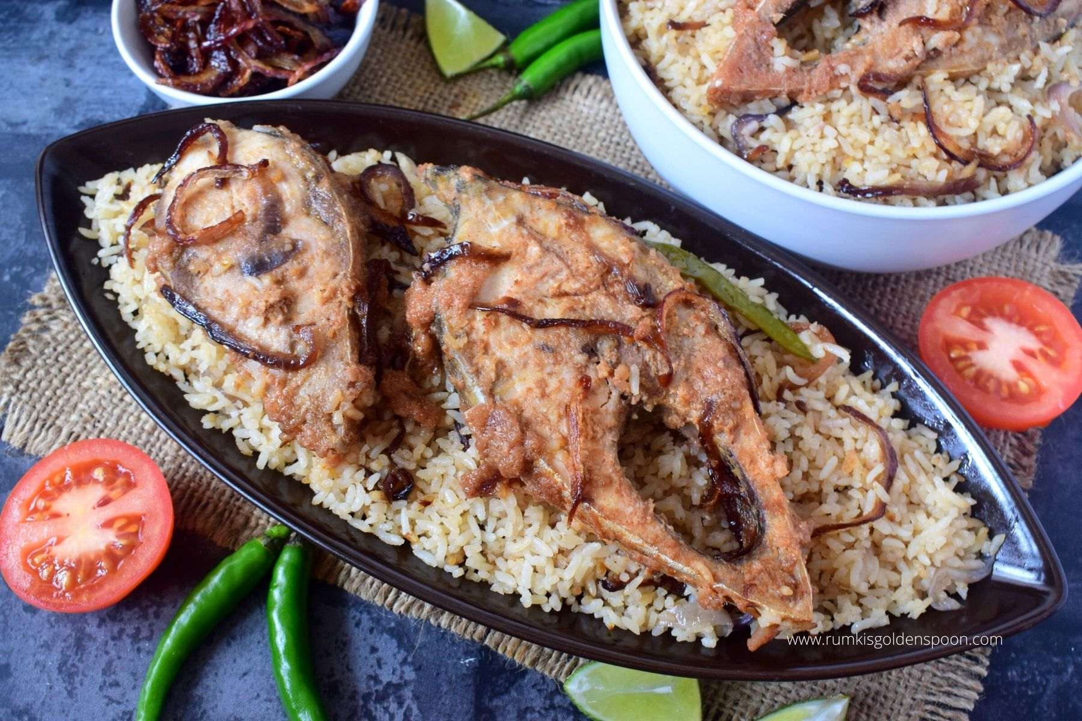
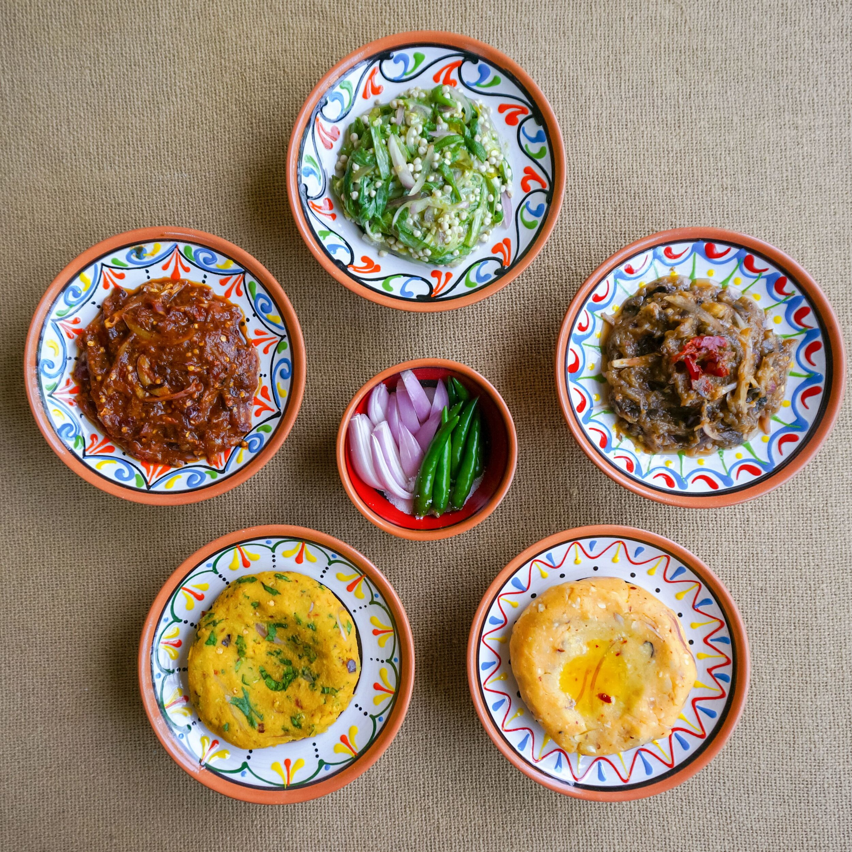
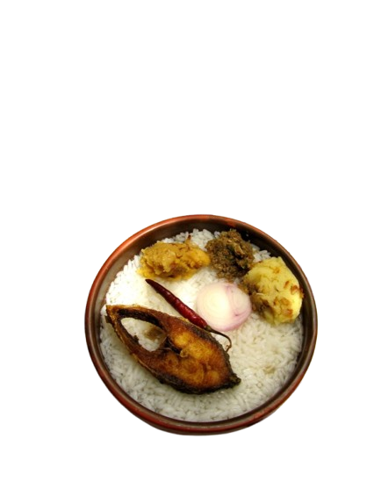
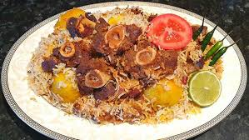
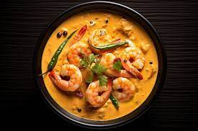
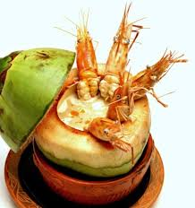
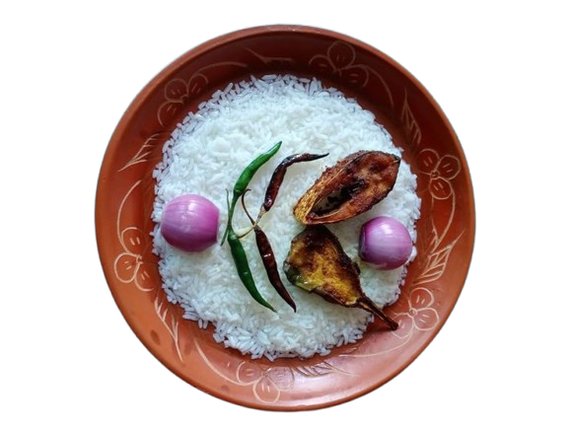
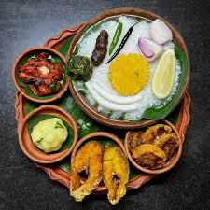



About Food
Some Popular Dish
Rice is the staple food in Bangladesh. Many types of rice are cultivated in Bangladesh, among which Polao rice is popular, which is famous for its test and aroma. Rice usually eaten with fish curry, lentils (Dal), vegetables, meat, beef and various types of curries and bhorta (mashed vegetables). Rice, fish curry, and lentils (dal) is the most common food for general people. There is a lot of fish available in Bangladesh, including the national fish Hilsa, so fish curry with rice is their main and traditional dish. And for this reason, the people of this country are called ‘Bengalis with fish and rice’.
Polao rice
Cooked polao
Chicken Roast
Hotchpotch
Mezbani Beef
Beef Jali Kabab
Ilish Polao
Traditional Food
Bhorta
Panta Bhat : The national dish of Bangladesh is Panta bhat which is cooked rice soaked in water and fermented, served with fried ilisha fish. Panta bhat also served with onion, green chilli or fried dried chilli and various kind of bhorta especially mashed potato (alu bhorta).
Kacchi Biryani
Prawns Malai Curry
Daab Chingri
Panta Bhat, Bhorta, Fried Fish
Duck carry
Fish Curry
Morog Polao

Slide 7




















D E S S E R T S
Bangladesh is known for many desserts like rice cakes (pitha), rice puddings, vermicelli (shemai), including sweets such as roshogolla, roshomalai, chomchom, chanar Sandesh (cottage cheese) sweet yogurt (doi) are famous desserts. There is a saying that Bengalis remain unsatisfied if they do not eat sweets after meal. Shemai (vermicelli) and rice pudding (payesh) are traditional dish in Bangladesh.
Sandash Phita
Bhapa Pitha
Patishapta
Shemai (vermicelli) is traditional dish in Bangladesh. Shemai is a popular dessert item during Eid which is soaked in hot sweet milk and often garnished with raisins and nuts.
Nokshi Phita
Puli Phita
Milk Puli
Rice pudding is also tradiotinal dessert which is especial rice called pilau rice cooked in milk and date molasses is added to sweetener.
Chitoi Pitha
Milk Chitoi
Fuljhuri Pitha
Rice cake (pitha) is famous desserts in Bangladesh and made with rice flour, milk, coconut, sugar or molasses. There are many types of pitha in Bangladesh that’s why called the ‘Land of Pithapuli’. More rice cakes are made during winter than all year.
Rosogolla
Sweet Yogurt
Rosomalai
Chomchom
Malai Chomchom
Kalo jam
Sandesh/Burfi

Slide 8
D I S H E S
Chicken Roast
Plain Polao
Ingredients: Chicken Leg – 1 kg ,
Step 01: Special Mixed Spice: Cardamom - 2.5 tbsp, Cinnamon – 1.5 tbsp, Cumin – 1.5 tbsp, Black Cardamom – 4pcs ,Mace – 1 tsp, Nutmeg – 1 pc, White Peppercorn Powder – 1 tsp,
Step 02: Kashmiri Chilli Powder – 1 tsp ,Salt to taste ,
Step 03: Mixed Masala Paste: Plain Yogurt – ½ Cup, Tomato Ketchup – 2 tbsp, Cashew Nut Paste – 2 tbsp, Onion Paste – ½ Cup, Ginger Paste – 1.5 tbsp, Garlic Paste – 1 tbsp, White Pepper Powder – 2 tsp, Special Mixed Spice – 1 tsp (Step 01), Cumin Powder – 1 tsp, Coriander Powder – ½ tsp,
Step 04: Cooking Oil – ¾ Cup, Ghee – 2 tbsp, Fried Onion (Barista) – 2 Cup,
Step 06: Milk – 1 Cup, Poppy Seed Paste – 1 tbsp,
Step 07: Barista – 2 cup (Step 04), Garam Masala – ½ tsp, Nutmeg & Mace Powder – ½ tsp,
Step 08: Cinnamon Stick – 6pcs (small), Black Cardamom – 1pc, Green Cardamom - 4pcs, Cloves – 3-4pc,s Bay Leaf – 4pcs, Mix Masala Paste (Step 03) Water, Salt to Taste, Green Chilli – 6-7pcs, Milk – 1 Cup, (Step 06) Barista (Step 07), Sugar – 2 tsp, Rose Water – 10-12 Drops, Kewra Water – 8-10 Drops.
Ingredients:
Chinigura / Aromatic Rice 1 kg, Chopped onions 1/2 cup, Oil 2 tbsp, Ghee 2 tbsp. Masala: Black Pepper 8-10, Whole Clove 5, Cardamom 5, Cinnamon sticks 2 to 3, Salt 2 tsp, Ginger paste 1 tbsp. Sugar 1 tsp, Milk 1cup, Water 6 cups, Fried Onion (Barista) and Raisin for decoration.
Method:
step 01: Wash the rice well and soak it for 15 to 20 minutes. Then it needs to be drained well.
Step 02: Heat oil in a pan, add chopped onion , Masala(spice) and fry its, then add drained rice and fry 10 to 15 minutes. Add water, milk. When the rice half cooked add sugar and whole green chilli 2 to 3, wait for the rice to cook properly.
Step 03: Must be served with fried onion and raisin (optional).
Cooked polao
Method: Marinate chicken overnight with salt and ginger. Then heat oil and shallow fry the chicken pieces on both sides well and keep it aside. In a pan add clarified butter when it heats up add cinnamon, green cardamom, bay leaf and cloves. Now add paste of onions, curd and garlic. Give a stir to the mixture and add the chicken pieces to it. Add salt and red chili powder and cook for 10 minutes till the chicken tenderize. In the blender make a paste of a raisins and poppy seeds with little water. Add this paste to the chicken. Stir well, add rose water. As oil leaves sides and the chicken tenderize completely Add fresh cream and give it a good mix and serve hot.
Sondesh Pitha
Sondesh Pitha is popular in Bangladesh. Hear’s what you need to make it.
Ingredients:
Fine Rice Flour = 2 cup
Plain Flour = 1 cup
Date Molasses/ Suger = 250g/according to the test
Luke Warm Water = 450g
Salt = ¼ tsp
Cooking Oil (Deep Frying) = 1 to 1.5 Litter
Mix all the ingredients together in a bowl and let sit for 10 to 15 minutes. After this, add some oil to a pan for deep frying. When the oil is hot, add a little batter and fry it.
Sandash Phita
Chicken Roast

Slide 9














DRESSES
Bangladesh is famous for its ready-made garments (RMG) and cotton fabric all over the world. In 2024, Bangladesh is the second top position in the world in exports of ready-made garments. International brands import ready-made-garments form Bangladesh such as John Lewis, Zara, Next, M&S, Gap, H&M, Primark etc. Bangladeshi people feel proud for that.
Some Wedding Dresses
Men wear a panjabi for cultural and religious occasions. They also wear shirt, pants, tie, suits for formal occasions and wear a lungi for casual moreover fotua, t-shirt, polo shirt,, jeans, trousers.
Bangladeshi traditional dress is saree for woman and men for Panjabi.
Panjabi & Koti
Polo Shrit
Formal dress
Formal & Occasions
Fotua
Lungi
Casual dress

Slide 10





















Collection of women Dress
Women wear saree, lehenga in wedding, festivals and also typical hand loom saree, floral print saree and shalwar kameez for casual wear.
Dhakai Jamdani
Gadwal Silk
Rajshahi Silk
Katan Silk
Benaroshi
Shalwar Kameez
Bangladesh is famous for Dhakai Jamdani which is a once-world-famous fabric, and Muslin, a fine and artistic cloth. Khadi, or khaddar, katan, benaroshi, hand loom, silk, Rajshahi silk etc are famous also.
Muslin / Organza
Hand Loom Cotton
Rural women in Floral Print cotton Saree

Slide 11

Everyone is invited to enjoy the beauty of Bangladesh and explore its culture.

